Slide 1
MCA II , SEM III
IT 32: Data Warehouse and Data Mining
Session-1 & 2
Introduction of Data Warehouse
Dr. Ashwini Brahme
Dr. Ashwini Brahme

Slide 2
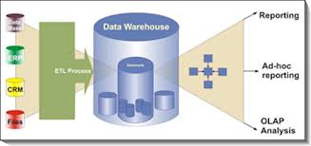
Data Ware Housing and Data Mining
IT-32

Slide 3
Syllabus
1. Data Warehouse Fundamentals 1.1. Introduction to Data Warehouse, OLTP Systems; Differences between OLTP Systems and Data Warehouse: 1.2. Characteristics of Data Warehouse; Functionality of Data Warehouse: 1.3. Advantages and Applications of Data Warehouse; Top- Down and Bottom-Up Development Methodology: 1.4. Tools for Data warehouse development: Data 15 6 Warehouse Types 1.5. Planning and Project Management in constructing Data warehouse: Data Warehouse Project; 1.6. Data Warehouse development Life Cycle, Kimball Lifecycle Diagram
2. Data Warehouse Architecture 2.1. Introductions, Components of Data warehouse Architecture 2.2. Technical Architectures; Federated Data Warehouse Architecture: Tool selection; 2.3. Dimensional Modeling: E-R Modeling VS Dimensional Modeling 2.4. Data Warehouse Schemas; Star Schema, Inside Dimensional Table, Inside Fact Table, Fact Less Fact Table, Granularity, Star Schema Keys: Snowflake Schema, Fact Constellation Schema 2.5. Introduction to Metadata : Categorizing Metadata: 2.6. Metadata management in practice; Meta data requirements gathering, Metadata classification, Meta data collection strategies, Tools for Metadata Management
3 3. Data Preprocessing and ETL 3.1. Data Pre-processing: Data Cleaning tasks 3.2. Data Integration and Data Reduction 3.3. Discretization and Concept Hierarchy Generation 3.4. Data Transformation; Basic Tasks in Transformation, Major Data Transformation Types 3.5. Introduction to ETL(Extract, Transform and Load) 3.6. ETL requirements and steps: Data Extraction; Extraction Methods, Logical Extraction Methods, Physical Extraction Methods 3.7. Data loading; Data Loading Techniques, ETL Tools
Dr. Ashwini Brahme

Slide 4
Syllabus
4. Data Warehouse & OLAP: 4.1. Introduction: What is OLAP?; Characteristics of OLAP, 4.2. Steps in the OLAP Creation Process, OLAP operations, Advantages of OLAP: Multidimensional Data: 4.3. OLAP Architectures; MOLAP, ROLAP, HOLAP: 4.4. Data Warehouse and OLAP: Hypercube & Multicubes
5. Introduction to Data Mining: 5.1. Introduction and Scope of Data Mining 5.2. How does Data Mining Works, Predictive Modeling 5.3. Data Mining and Data Warehousing 5.4. Architecture for Data Mining 5 4 5.5. Profitable Applications: Data Mining Tools:
6. Data Mining Techniques 6.1. An Overview: Introduction, Data Mining, Data Mining Versus Database Management System, 6.2. Data Mining Techniques- Association rules( Apriori, FP Tree algorithms) 6.3. Classification (Decision Tree induction, Bayesian classification, SVM, KNN) 6.4. Clustering, Neural networks. 6.5. Evaluating Association rules , Classification model
7. Clustering 7.1. Introduction to Clustering, Cluster Analysis 7.2. Clustering Methods- K means, Hierarchical clustering, Agglomerative clustering, Divisive clustering, 7.3. clustering and segmentation software 7.4. Evaluating clusters 7.5. Data Mining trends and Applications
8. Web Mining 8.1. Introduction, Terminologies 8.2. Categories of Web Mining: Web Content Mining, Web Structure Mining, Web Usage Mining 8.3. Applications of Web Mining, and Agent based and Database approaches, Web mining Software/Tools. 8.4. Text Mining: process and types, steps in Text Mining, applications and tools of Text Mining 8.5. Data visualization, Dashboard- KPI, Business Intelligence and its future.
Dr. Ashwini Brahme

Slide 5
Topic Content
        Introduction of Data Warehouse
        History of Data Warehouse
        Operational Data Base VS Data warehouse
        Data Warehouse Architecture
        Approaches in Data Warehouse
        Working of Data Warehouse
        Type of Data Warehouse
        General Stages of Data Warehouse
        Components of Data Warehouse
        Who Needs Data Warehouse?
        Steps to Implement Data Warehouse
        Best Practices to implement Data Warehouse
        Data Warehouse Advantages and Disadvantages
        Data Warehouse Future
        Data Warehouse Applications
        Data Warehouse Tools
        Conclusion
Dr. Ashwini Brahme

Slide 6
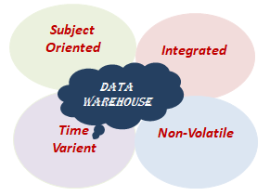
Data Ware Housing
Data Warehouse
Bill Inmon
First coined in late 1980s by
As
Data warehouse is a subject-oriented, integrated, time-variant, and non-volatile collection of data. This data helps analysts to take informed decisions in an organization.
Dr. Ashwini Brahme

Slide 7
Data Warehousing
Subject Oriented - A data warehouse is subject oriented because it provides information around a subject rather than the organization's ongoing operations. These subjects can be product, customers, suppliers, sales, revenue, etc. A data warehouse does not focus on the ongoing operations, rather it focuses on modelling and analysis of data for decision making.
Integrated – A data warehouse is constructed by integrating data from heterogeneous sources such as relational databases, flat files, etc. This integration enhances the effective analysis of data.
Time Variant - The data collected in a data warehouse is identified with a particular time period. The data in a data warehouse provides information from the historical point of view.
Non-volatile - Non-volatile means the previous data is not erased when new data is added to it. A data warehouse is kept separate from the operational database and therefore frequent changes in operational database is not reflected in the data warehouse.
Dr. Ashwini Brahme

Slide 8
Data Warehousing
It is also known as technique for collecting and managing data from variety of sources to provide meaningful business insights. It is a cluster of technologies and components that allow the strategic use of data.
It is an electronic storage of a large amount of information by a business which is designed for query and analysis. It is a process of transforming data into information and making it available to users.
The decision support database (Data Warehouse) is maintained in different method from the organization’s operational database. Many people mistake data warehouse to be a product which actually is an environment.
To be more elaborate it is actually an architectural construct that belong to an informational system on the other hand it offers the users with information that support historical and current decision there is actually very much difficult for accessing the traditional operational data store
Dr. Ashwini Brahme

Slide 9
History of Data Warehouse
1960- Dartmouth and General Mills jointly coined the definition dimensions and facts. Dimensional data marts for retail sales was introduces in the year 1970 by Nielsen.
A company called Tera Data Corporation in 1983- introduced a specifically designed
data base management system for decision support.
IBM worker Paul Murphy and Barry Devlin developed the Business Data Warehouse the late 1980s and from then on data warehousing started.
On the contrary the master mind behind data warehousing is Inmon Bill he is considered the father of data warehouse. He has considered his writing about maintenance of the warehouse and the corporate information factory building and usage
This concept is used to provide an architectural model for the flow of data from operational systems to various decision support environments.
Dr. Ashwini Brahme

Slide 10
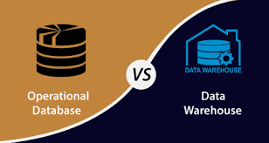
Operational Database Vs Data Warehouse
500 TB
Text, Audio, Video per day
Dr. Ashwini Brahme

Slide 11
Operational Data Base
Operational Database
Changes
Undergoes Frequent
Based on daily transactions
Suppose, A business executive wants to analyze previous feedback on any data such as a product, a supplier, or any consumer data, then the executive will have no data available to analyze because the previous data has been updated due to transactions. It use Online Transaction Processing (OLTP)
Note: Operational data Base require transaction processing, recovery, and concurrency controls, because it is physically stored and separate from the operational database.
Dr. Ashwini Brahme

Slide 12
Data Warehouse
Data Warehouse
Changes
Undergoes rare
A data warehouses provides us generalized and consolidated data in multidimensional view. Along with generalized and consolidated view of data, a data warehouses also provides us Online Analytical Processing (OLAP) tools. These tools help us in interactive and effective analysis of data in a multidimensional space. This analysis results in data generalization and data mining.
Note: A data warehouse does not require transaction processing, recovery, and concurrency controls.
Dr. Ashwini Brahme

Slide 13
Difference Between OD vs DWH
Data Warehouse(OLAP) | Operational Database(OLTP)
It involves historical processing of information. | It involves day-to-day processing.
OLAP systems are used by knowledge workers such as executives, managers, and analysts. | OLTP systems are used by clerks, DBAs, or database professionals.
It is used to analyze the business. | It is used to run the business.
It focuses on Information out | It focuses on Data in.
It is based on Star Schema, Snowflake Schema, and Fact Constellation Schema. | It is based on Entity Relationship Model.
It provides summarized and consolidated data. | It provides primitive and highly detailed data.
The number of users is in hundreds. | The number of users is in thousands.
The number of records accessed is in millions. | The number of records accessed is in tens.
The database size is from 100GB to 100 TB. | The database size is from 100 MB to 100 GB
These are highly flexible | It provides high performance.
Dr. Ashwini Brahme

Slide 14
Data Warehouse Architecture
Data warehouse architecture is complex as it’s an information system that contains historical and commutative data from multiple sources. There are 3 approaches for constructing data-warehouse:
1. Single Tier,
2. Two tier and
3. Three tier are explained as below.
Single-tier architecture: The objective of a single layer is to minimize the amount of data stored. This goal is to remove data redundancy. This architecture is not frequently used in practice.
Two-tier architecture: Two-layer architecture separates physically available sources and data warehouse. This architecture is not expandable and also not supporting a large number of end-users. It also has connectivity problems because of network limitations.
Dr. Ashwini Brahme

Slide 15
Data Warehouse
Who needs Data warehouse?
User who need mass amount of data
It helps user who obtain customized difficult processes to receive information from various data source
It benefits people who demand basic technology to access the data
Users who requires a perfect approach to taking decisions
For users who require fast performance on a huge amount of data which is a necessary for obtaining charts grids an reports
Users who want to identify the hidden patterns of grouping and data flows
Dr. Ashwini Brahme

Slide 16
Applications of Data Warehouse
Data Warehouse Used For?
Financial services : Credit Card Analysis, Fraud Detection
Insurance: Claims, Fraud Analysis
Consumer goods: Promotion Analysis
Telecommunication: Call Record Analysis
Transport: Logistic Management
Airline: Flight Management
Health Care: generate patient’s disease reports, treatment outcome share data with the medical aid services, and insurance company.
Public Sector: in government sector to properly analysis the details of very individuals health records tax record. It is also used for intelligence gathering
Retail Chain: marketing and distributing
Hospitality Industry: to estimate and design, to promote campaigns and advertising
Dr. Ashwini Brahme

Slide 17
Advantages & Disadvantages of Data Warehouse
Advantages:
It permits the user to gather and access critical data from sources and put them together in a place
Data warehouse give constant information about different cross functional performance. It also supports ad-hoc query and reporting
Data warehouse allows the user to integrate and restructure which allows the user to easily analyze an report
Data warehouse helps the user to be time effective in analyzing and reporting. it also help the user to access many important data from various sources by a single touch
Data warehouse helps the user to predict the upcoming future as its stores the large amount of historical data.
Dr. Ashwini Brahme

Slide 18
Advantages of Data Warehouse
Disadvantages:
It is not advisable option for unstructured data
The implementation process of data ware house is time consuming process
The beginner finds too difficult to use the data ware house .at the same time data warehouse can be outdate very quickly
It is very much difficult to make few changes in quires indecs data sources scheme and data typos and ranges
Dr. Ashwini Brahme

Slide 19
Top Down & Bottom up Development Methodology
Approaches of Data Warehouse:
There are two approaches in data warehousing top down and bottom up.
Top down and
Bottom up.
The top down approaches spins off data marts for specific groups of users after the complete data warehouse has been created.
The bottom up approach builds the data marts first and then combines them into a single all-encompassing data warehouse.
A data warehouse is housed on an enterprise mainframe server, in the cloud. Data from various online transaction processing (OLTP) applications and other sources is selectively extracted.
Dr. Ashwini Brahme

Slide 20
How data warehouse works
A Data Warehouse is the power house where the information is received from many data sources. Data is received into a data warehouse from other data bases. Data is classified into 3 different sections which include
Structured
Semi-structured 3. Unstructured data.
The data is inhaled, transfigured and processed and thereby allowing the user to access the data which is processed via, SQL clients, and spreadsheets. In addition to this information is joined from different sources through data warehouse into a single comprehensive database.
Through this the customer can accurately analyze because all the information is merged in on place. This process also ensures that the data and information is considered by the data warehouse properly. Another benefit of data warehousing is it allow data mining which actually lead to better sales and higher profits through the pattern system.
Dr. Ashwini Brahme

Slide 21
Data Warehouse Types
There are three types of Data Warehouse
Enterprise Data Warehouse
Operational Data Store
Data Mart
Enterprise Data Warehouse: It offers decision support services throughout the Enterprise. It is also a centralized warehouse. It provides a uniformed and unique approach in representing and organizing data. Enterprise data ware house helps the user to select identify and access based on division and differentiate data based on the subject.
Operational Data Store: Operational Data Store operates as a substitute which neither OLTP nor data warehouse support reporting. Data warehouse is refreshed from time to time in operational data store. Therefore, operational data store is usually used for regular activities which include storage of employee’s record. .
Data Mart: is exclusively designed for the business which it holds data only for a specific department or line of business, such as sales, finance, or human resources. A data warehouse can feed data to a data mart, or a data mart can feed a data warehouse.
Dr. Ashwini Brahme

Slide 22
Data Warehouse Tools
Amazon Redshift
Microsoft Azure
Google BigQuery
Snowflake
Micro Focus Vertica
Teradata
Amazon DynamoDB
PostgreSQL
Amazon RDS
Amazon S3
SAP HANA
MarkLogic
MariaDB
Db2 Warehouse
Exadata
BI360 Data Warehouse
Cloudera
.
Dr. Ashwini Brahme

Slide 23
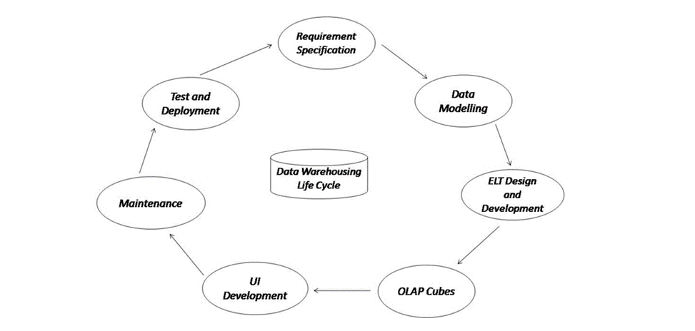
Data warehouse Development Life Cycle
Data Warehousing is a flow process used to gather and handle structured and unstructured data from multiple sources into a centralized repository to operate actionable business decisions.
With all of your data in one place, it becomes easier to perform analysis, reporting and discover meaningful insights at completely different combination levels.
A data warehouse setting includes extraction, transformation, and loading (ELT) resolution, an online analytical processing (OLAP) engine, consumer analysis tools, and different applications that manage the method of gathering data and delivering it to business.
.
Dr. Ashwini Brahme

Slide 24
Data warehouse Development Life Cycle
Requirement Specification: It is the first step in the development of the Data Warehouse and is done by business analysts. In this step, Business Analysts prepare business requirement specification documents. More than 50% of requirements are collected from the client side and it takes 3-4 months to collect all the requirements. After the requirements are gathered, the data modeler starts recognizing the dimensions, facts & combinations based on the requirements. We can say that this is an overall blueprint of the data warehouse. But, this phase is more about determining business needs and placing them in the data warehouse.
Data Modelling: This is the second step in the development of the Data Warehouse. Data Modelling is the process of visualizing data distribution and designing databases by fulfilling the requirements to transform the data into a format that can be stored in the data warehouse. For example, whenever we start building a house, we put all the things in the correct position as specified in the blueprint. That’s what data modeling is for data warehouses. Data modelling helps to organize data, creates connections between data sets, and it’s useful for establishing data compliance and its security that line up with data warehousing goals. It is the most complex phase of data warehouse development. And, there are many data modelling techniques that businesses use for warehouse design. Data modelling typically takes place at the data mart level and branches out in a data warehouse. It’s the logic of how the data is stored concerning other data. There are three data models for data warehouses:
  Star Schema
  Snowflake Schema
  Galaxy Schema.
.
Dr. Ashwini Brahme

Slide 25
Data warehouse Development Life Cycle
ELT Design and Development: This is the third step in the development of the Data Warehouse. ETL or Extract, Transfer, Load tool may extract data from various source systems and store it in a data lake. An ETL process can extract the data from the lake, after that transform it and load it into a data warehouse for reporting. For optimal speeds, good visualization, and the ability to build easy, replicable, and consistent data pipelines between all of the existing architecture and the new data warehouse, we need ELT tools. This is where ETL tools like SAS Data Management, IBM Information Server, Hive, etc. come into the picture. A good ETL process can be helpful in constructing a simple yet functional data warehouse that’s valuable throughout every layer of the organization.
OLAP Cubes: This is the fourth step in the development of the Data Warehouse. An OLAP cube, also known as a multidimensional cube or hypercube, is a data structure that allows fast analysis of data according to the multiple dimensions that define a business problem. A data warehouse would extract information from multiple data sources and formats like text files, excel sheets, multimedia files, etc. The extracted data is cleaned and transformed and is loaded into an OLAP server (or OLAP cube) where information is pre-processed in advance for further analysis. Usually, data operations and analysis are performed using a simple spreadsheet, where data values are arranged in row and column format. This is ideal for two-dimensional data. However, OLAP contains multidimensional data, with data typically obtained from different and unrelated sources. Employing a spreadsheet isn’t an optimum choice. The cube will store and analyze multidimensional data in a logical and orderly manner. Now, data warehouses are now offered as a fully built product that is configurable and capable of staging multiple types of data. OLAP cubes are becoming outdated as OLAP cubes can’t deliver real-time analysis and reporting, as businesses are now expecting something with high performance.
.
Dr. Ashwini Brahme

Slide 26
Data warehouse Development Life Cycle
UI Development: This is the fifth step in the development of the Data Warehouse. So far, the processes discussed have taken place at the backend. There is a need for a user interface for how the user and a computer system interact, in particular the use of input devices and software, to immediately access the data warehouse for analysis and generating reports. The main aim of a UI is to enable a user to effectively manage a device or machine they’re interacting with. There are plenty of tools in the market that helps with UI development. BI tools like Tableau or PowerBI for those using BigQuery are great choices.
Maintenance: This is the sixth step in the development of the Data Warehouse. In this phase, we can update or make changes to the schema and data warehouse’s application domain or requirements. Data warehouse maintenance systems must provide means to keep track of schema modifications as well, for instance, modifications. At the schema level, we can perform operations for the Insertion, and change dimensions and categories. Changes are, for example, adding or deleting user-defined attributes.
Test and Deployment: This is often the ultimate step in the Data Warehouse development cycle. Businesses and organizations test data warehouses to ensure whether the required business problems are implemented successfully or not. The warehouse testing involves the scrutiny of enormous volumes of data. Data that has to be compared comes from heterogeneous data sources like relational databases, flat files, operational data, etc. The overall data warehouse project testing phases include: Data completeness, Data Transformation, Data is loaded by means of ETL tools, Data integrity, etc. After testing the data warehouse, we deployed it so that users could immediately access the data and perform analysis. Basically, in this phase, the data warehouse is turned on and lets the user take the benefit of it. At the time of data warehouse deployment, most of its functions are implemented. The data warehouses can be deployed at their own data center or on the cloud.
.
Dr. Ashwini Brahme

Slide 27
Data Warehouse Architecture
Three-tier architecture: This is the most widely used architecture. It consists of the,
1. Top,
2. Middle and
3. Bottom Tier.
Bottom Tier: The database of the Data warehouse servers as the bottom tier. It is usually a relational database system. Data is cleansed, transformed, and loaded into this layer using back-end tools.
Middle Tier: The middle tier in Data warehouse is an OLAP server which is implemented using either ROLAP or MOLAP model. For a user, this application tier presents an abstracted view of the database. This layer also acts as a mediator between the end-user and the database.
Top-Tier: The top tier is a front-end client layer. Top tier is the tools and API that you connect and get data out from the data warehouse. It could be Query tools, reporting tools, managed query tools, Analysis tools and Data mining tools.
Dr. Ashwini Brahme

Slide 28
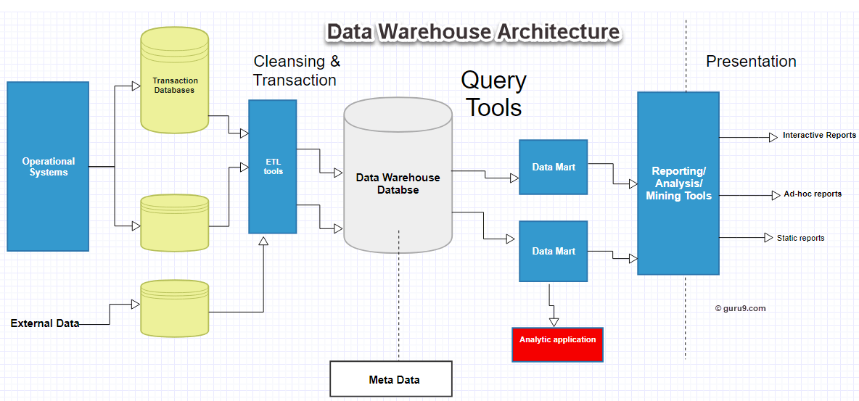
Tree-Tier Architecture
Staging
Data Sources
Users
Data Marts
Dr. Ashwini Brahme

Slide 29
Data Warehouse Architecture
There are mainly Nine components of Data Warehouse
Data Base/Data Source
Data Extraction
Staging
Sourcing, Acquisition, Clean-up and Transformation Tools (ETL)
Data Storage
Data Logic
Data Presentation
Meta Data
Query Tool/System Operation
The process of gathering, cleaning and integrating data from various sources, usually from long-term existing operational systems is in part for each environment. The operational systems are frequently reexamined as new decision support a requirement emerges. Often new requirements require gathering, cleaning and integrating new data from "data marts" which is tailored for instant access by users.
Data warehouse which is also known as an enterprise data warehouse is a system used for reporting and data analysis. It is also considered as a core component of business intelligence. The data stored in the warehouse is uploaded from the operational systems. The data passes through an operational data store and will require data cleansing for additional operations to ensure data quality before it is used in the Data Warehouse for reporting.
Dr. Ashwini Brahme

Slide 30
Data Warehouse Architecture
The typical Extract, transform, load (ETL)- based data warehouse uses staging, data integration, and access layers to express its key functions.
The staging layer database stores raw data taken from each of the disparate source data systems.
The integration layer integrates the disparate data sets by transforming the data from the staging layer often storing this transformed data in an operational data store (ODS) database.
The integrated data are then moved to yet another database, often called the data warehouse database, where the data is arranged into hierarchical groups and into facts and aggregate facts.
Star schema is the name coined for the combination of facts and dimensions the users can retrieve data through access layer
Dr. Ashwini Brahme

Slide 31
Data Warehouse Architecture
The main source of the data is cleansed, transformed, catalogued and made available for use by managers and other business professionals for data mining, online analytical processing, market research and decision support.
The method to retrieve and analyze data, to extract, transforms, and load data, and to manage the data dictionary are also important for a data warehousing system.
An expanded definition for data warehousing includes business intelligence tools, tools to extract, transform and load data into the repository and tools to manage and retrieve metadata.
Data warehousing emphasizes the capture of data from data mart diverse sources for useful analysis and access start from the point-of-view of the end user who may need access to specialized, sometimes local databases.
Dr. Ashwini Brahme

Slide 32
Approaches in Data Ware Housing
There are two approaches in data warehousing.
1. Top down and
2. Bottom up.
The top down approaches spins off data marts for specific groups of users after the complete data warehouse has been created.
The bottom up approach builds the data marts first and then combines them into a single all-encompassing data warehouse.
A data warehouse is housed on an enterprise mainframe server , in the cloud. Data from various online transaction processing (OLTP) applications and other sources is selectively extracted.
Dr. Ashwini Brahme

Slide 33
How Data warehouse works
A Data Warehouse is the power house where the information is received from many data sources. Data is received into a data warehouse from other data bases. Data is classified into 3 different sections which include
        1. Structured
        2. Semi-structured
        3. Unstructured data.
The data is inhaled, transfigured and processed and thereby allowing the user to access the data which is processed via, SQL clients, and spreadsheets.
In addition to this information is joined from different sources through data warehouse into a single comprehensive database.
This process also ensures that the data and information is considered by the data warehouse properly.
Another benefit of data warehousing is it allow data mining which actually lead to better sales and higher profits through the pattern system.
Dr. Ashwini Brahme

Slide 34
Types of Data Warehouse
There are three types of Data Warehouse
1. Enterprise Data Warehouse
2. Operational Data Store
3. Data Mart
Enterprise Data Warehouse offers decision support services throughout the Enterprise. It is also a centralized warehouse. It provides a uniformed and unique approach in representing and organizing data. Enterprise data ware house helps the user to select identify and access based on division and differentiate data based on the subject .
Operational Data Store operates as a substitute which neither OLTP nor data warehouse support reporting. Data warehouse is refreshed from time to time in operational data store. Therefore operational data store is usually used for regular activities which include storage of employee’s record. .
Data Mart is exclusively designed for the business which it holds data only for a specific department or line of business, such as sales, finance, or human resources. A data warehouse can feed data to a data mart, or a data mart can feed a data warehouse.
Dr. Ashwini Brahme

Slide 35
Data Warehouse Vs Data Mart
 | Data Ware House | Data Mart
Objective | Centralize data, become single source of truth across business | Provide easy access to data for a department or specific line of business
Uses | Business-wide analysis | Department-specific analysis
Decision types | Strategic decision-making | Operational or tactical decision-making
Scope | Wide; contains data from all departments and lines of business | Specific; individual data marts for individual departments
Size | Typically more than 100GB | Less than 100GB
Data held | All organizational data | Single business line
Data sources | Dozens or hundreds | Typically just a few
Time to implement | Months to years (on-premises); days to weeks (cloud-based) | Weeks to months (on-premises); days to weeks (cloud-based)
Cost | $100K+ (on-premises); on-demand pricing varies (SaaS) | $10K (on-premises); on-demand pricing varies (SaaS)
Dr. Ashwini Brahme

Slide 36
General stages of Data Warehouse
General Stages of Data Warehouse are as follows,
1. Offline Operational Database
2. Offline Data Warehouse
3. Real Time Data Warehouse
4. Integrated Data Warehouse
In Offline Operational Database the data is transformed from operational system to a server. Processing, reporting and loading of the copied data hover impact the performance of the operational systems
In Offline Data Warehouse data is frequently updated from the Operational Database. The transformation of data in the Data warehouse is done to meet the objectives of Data warehouse
During Real time Data Warehouse stage every data warehouses are refreshed and updated during a transaction. For instance this is done when a ticket is booked in an airline or in a railway booking system.
In Integrated Data Warehouse stage leads to the next process that is when an transaction takes place. The transaction is generated through the Data Warehouses to the operational system
Dr. Ashwini Brahme

Slide 37
Components of Data warehouse
Components of Data warehouse are as follows
1. Load manager
2. Data Warehouse Manager
3. Query Manager
4. End-user Access Tools
Load Manager extract an input data into the warehouse its otherwise called as the front component. It also transforms the preparation of data to enter in to a data.
Data Warehouse Manager does operation which is closely associated with managing the data in the warehouse. It analysis data to conform creation of induces and view consistency, de-normalization and aggregations
Query Manager is very well known as backend component. It assists the entire operation operations related to the user queries.
End-user access tools includes five different groups like
        1. Data Reporting
        2. Query Tools
        3. Application development tools
        4. EIS tools,
        5. OLAP tools and data mining tools.
Dr. Ashwini Brahme

Slide 38
Who needs Data warehouse?
User who need mass amount of data
It helps user who obtain customized difficult processes to receive information from various data source
It benefits people who demand basic technology to access the data
Users who requires a perfect approach to taking decisions
For users who require fast performance on a huge amount of data which is a necessary for obtaining charts grids an reports
Users who want to identify the hidden patterns of grouping and data flows
Dr. Ashwini Brahme

Slide 39
Steps to Implement Data Warehouse
Data Warehouse implementation is to employ a three-prong strategy as below
1. Enterprise Strategy
2. Phased Delivery
3. Iterative Prototyping
Enterprise strategy: Data transformation and data mapping is fast through this
strategy, and at the same time attributes, dimension and fax are identified
Phased delivery: Data warehouse implementation is phased based upon subject areas. For instance business steps like booking and billing are first implemented and then integrated with one another.
Iterative Prototyping: In this method data ware house is developed and tested iteratively
Dr. Ashwini Brahme

Slide 40
Best practices to implement a Data Warehouse
First decide a plan to accurately identify the consistency and integrity of the data.
The data warehouse should be, well defined and well integrated
While designing Data warehouse make sure you use right tool, stick to life cycle, take care about data conflicts and ready to learn from your mistakes.
Don’t replace reports and operational systems
When designing data warehouse, conform that the right tool is being used and don’t spend much time on cleaning extracting and loading data.
Identify and implement a training plan for the end users
Try to involve all stack holder and business partners in data warehouse implantation process.
Dr. Ashwini Brahme

Slide 41
Data Warehouse Advantages
It permits the user to gather and access critical data from sources and put them together in a place
Data warehouse give constant information about different cross functional performance.
It also supports ad-hoc query and reporting
Data warehouse allows the user to integrate and restructure which allows the user to easily analyze an report
Data warehouse helps the user to be time effective in analyzing and reporting. it also help the user to access many important data from various sources by a single touch
Data warehouse helps the user to predict the upcoming future as its stores the large amount of historical data.
Dr. Ashwini Brahme

Slide 42
Data Warehouse Disadvantages
It is not advisable option for unstructured data
The implementation process of data ware house is time consuming process
The beginner finds too difficult to use the data ware house
At the same time data warehouse can be outdate very quickly
It is very much difficult to make few changes in quires indices data sources scheme and data typos and ranges
Dr. Ashwini Brahme

Slide 43
Future of Data Warehousing
The scope of data war housing are on the raise as the regulatory constraints changes from time to time.
It may limit the performance to combine different data from difference sources. This may include unstructured data which is usually a difficult one to store.
This is because the size of the data grows everyday data warehouse system helps the user to build and run data as a size grows
Dr. Ashwini Brahme

Slide 44
Data Warehouse Applications
Financial services : Credit Card Analysis, Fraud Detection
Insurance: Claims, Fraud Analysis
Consumer goods: Promotion Analysis
Telecommunication: Call Record Analysis
Transport: Logistic Management
Airline: Flight Management
Health Care: generate patient’s disease reports, treatment outcome share data with the medical aid services, and insurance company.
Public Sector: in government sector to properly analysis the details of very individuals health records tax record. It is also used for intelligence gathering
Retail Chain: marketing and distributing
Hospitality Industry: to estimate and design, to promote campaigns and advertising
Dr. Ashwini Brahme

Slide 45
Data Warehousing Tools
There are many Data Warehousing tools are available in the market.
      Amazon Redshift
      Microsoft Azure
      Google BigQuery
      Snowflake
      Micro Focus Vertica
      Teradata
      Amazon DynamoDB
      PostgreSQL
      Amazon RDS
      Amazon S3
      SAP HANA
      MarkLogic
      MariaDB
      Db2 Warehouse
      Exadata
      BI360 Data Warehouse
      Cloudera
Dr. Ashwini Brahme

Slide 46
Conclusion
A data warehouse is a database, which is kept separate from the organization's operational database.
There is no frequent updating done in a data warehouse.
It possesses consolidated historical data, which helps the organization to analyze its business.
A data warehouse helps executives to organize, understand, and use their data to take strategic decisions.
Data warehouse systems help in the integration of diversity of application systems.
A data warehouse system helps in consolidated historical data analysis.
Data mining functions such as association, clustering, classification, prediction can be integrated with OLAP operations to enhance the interactive mining of knowledge at multiple level of abstraction.
Dr. Ashwini Brahme

Slide 47
Thank You
Dr. Ashwini Brahme

